Slide 1
Jayanka Ghosh

Slide 2
Jayanka Ghosh (joy)

Slide 3
Jayanka Ghosh (joy)
Interceptor system in NexPWA

Slide 4
A little bit about me
Love to play the guitar
Work as a team lead in Codilar Technologies
Run a YouTube channel called MageCafé
Helped build and maintain NexPWA

Slide 5
What is NexPWA?

Slide 6
What is NexPWA
A solution based off of ScandiPWA

Slide 7
What is NexPWA
A solution based off of ScandiPWA
A suite of extensions to supercharge your Magento website

Slide 8
What is NexPWA
A solution based off of ScandiPWA
A suite of extensions to supercharge your Magento website
Performance and extendability

Slide 9
What is NexPWA
A solution based off of ScandiPWA
A suite of extensions to supercharge your Magento website
Performance and extendability
Demo: https://www.nexpwa.com/

Slide 10
Extendability in Magento

Slide 11
Ways to change Magento’s core
Preferences (meh...)
Events and Observers (too much work)
Plugins/Interceptors (this is what we’re concerned with today)

Slide 12
Plugins in Magento

Slide 13
The plugin system of Magento

Slide 14
The plugin system of Magento
Clean extendability

Slide 15
The plugin system of Magento
Clean extendability
Less chances of conflicts

Slide 16
The plugin system of Magento
Clean extendability
Less chances of conflicts
Easy to visualize

Slide 17
The plugin system of Magento
Clean extendability
Less chances of conflicts
Easy to visualize

Slide 18
Plugins in Magento NexPWA

Slide 19
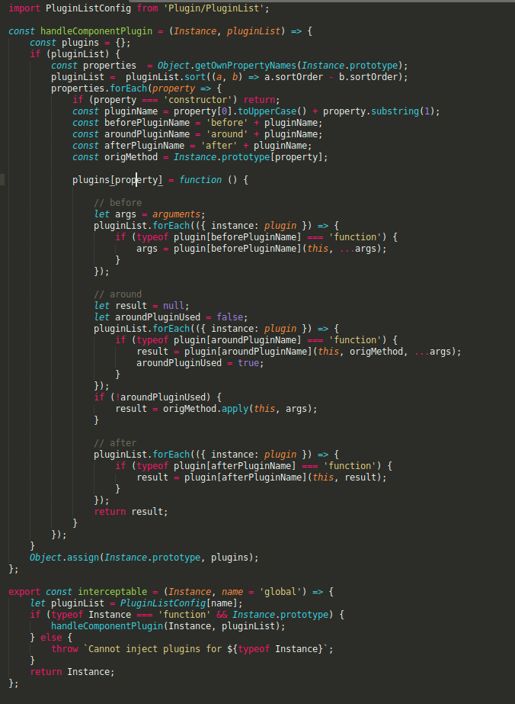

Slide 20
Magento’s approach
Object Manager
Interceptor
Auto-generated by Magento
Actual Class
Plugin List

Slide 21
Our approach
Interceptor HOC
React Component
Plugin List
Auto-generated by Magento

Slide 22
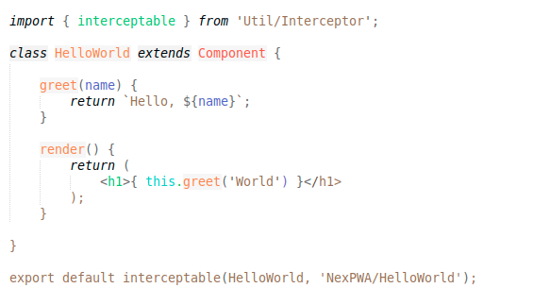
A “hello world” example

Slide 23
The di.xml

Slide 24
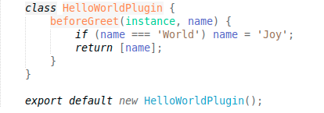
The plugin.js

Slide 25
Our approach

Slide 26
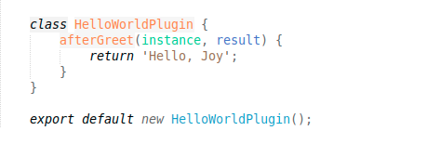
Our approach

Slide 27
Our approach
Yup, even the dreaded “around” plugin

Slide 28
And the best part?

Slide 29
The plugin list is injected through di.xml and auto generated by Magento

Slide 30
The plugin list is injected through di.xml and auto generated by Magento
Inject React plugins from Magento extensions!
Enable/disable plugins of one extension from another.
Modify the plugin of one extension using another extension.

Slide 31
If you’re still here, you must really love coding.
So, thank you, and happy coding!

